Slide 1

DEPARTMENT OF COMPUTER SCIENCE & ENGINEERING
SCHOOL OF COMPUTING
1156CS701- MAJOR PROJECT
INTERNSHIP THROUGH DDD/PLACEMENT/ABROAD
WINTER SEMESTER(21-22)
REVIEW - I
“BLOCKCHAIN BASED ACCOUNTS PAYABLE PLATFORM FOR GOODS TRADE”
SUPERVISED BY
Faculty Name
Designation
PRESENTED BY
VENKATESHWAR REDDY PUCHALA (VTU14738) (18UECSO923)

Slide 2
AGENDA
ABSTRACT
OBJECTIVE
INTRODUCTION
LITERATURE REVIEW
PROPOSED SYSTEM
DESIGN AND METHODOLOGIES
IMPLEMENTATION
ALGORITHAM
TESTING
RESULT ANALYSIS
CONCLUSION

Slide 3
ABSTRACT
Goods trade is a supply chain transaction that involves shippers buying goods from suppliers and carriers providing goods transportation. Various business documents like purchase order, despatch advice, invoices, and receive advice get exchanged among the trade participants during any trade transaction.
A blockchain-based accounts payable system for shippers, which generates claims for deficiency in the goods received and accordingly adjusts the payment in the bills for suppliers and carriers.

Slide 4

ABSTRACT- continued..
Primary motivations for these supply chain organizations to adopt blockchain-based accounts payable systems are to eliminate the process redundancies (accounts payable vs. accounts receivable), to reduce the number of disputes among the transacting participants, to reduce the dispute resolution time, and to accelerate the accounts payable processes via optimizations in the claims generation and blockchain-based dispute reconciliation.

Slide 5
OBJECTIVES
Aim of the Project:
Blockchain-based accounts payable system extending TradeLens platform to meet supply chain network participants' needs for invoice processing (creation of CA and PAs) and dispute resolution is proposed by the system.
Scope of the Project:
Our blockchain-based accounts payable platform has the following functionalities. EDI documents PO, DA, RA, and supplier invoice are used to construct the CA.
The shipper is entitled to pay to the supplier for the quantity of the accepted goods at the agreed price as per the purchase order.

Slide 6
INTRODUCTION
Any trade transaction, be it domestic or global, involves exercising certain processes to complete. Domestic trade is the exchange of goods within country boundaries in contrast to between different countries in global/international trade.
Payment processing involves executing a payment method as per the terms captured in the service contracts between trade participants. The most common payment method is open account, where the goods is shipped and delivered before the release of funds from the shipper within an agreed time frame.

Slide 7
INTRODUCTION- Continued…
The complexity of goods trade increases with the multiple en route handoffs between different parties involved in the goods over ment process. End-to-end shipping visibility becomes significantly challenging to put together.
Moreover, our system lets the reconciled and approved CA and PAs be sent to the customer’s (shipper, supplier, or carrier) existing ERP systems via the API interfaces. Thus, our system is seamlessly integrated with the customer’s downstream applications.

Slide 8
LITERATURE REVIEW

Slide 9
TITLE: “Blockchain based e-invoicing platform for global trade,” AUTHORS’S: K. Narayanam, S. Goel, A. Singh, Y. Shrinivasan, S. Chakraborty, P. Selvam, V. Choudhary, and M. Verma,
This paper presents a blockchain-based e-invoice generation system for the goods carriers where one or more goods carriers are involved in the shipper's goods movement from origin location in one country to a destination location in another country. The generation of an invoice for a carrier primarily uses real-time shipment tracking information and pre-agreed service contract rates between the shipper and the carrier. Our system enhances e-invoicing process efficiency and lower costs for the shippers and carriers participating in global trade. The primary motivations for the organizations to adopt blockchain-based e-invoicing systems are to reduce the number of disputes on invoices, reduce dispute resolution time, and provide real-time auditing.

Slide 10
TITLE: “Blockchain-enabled trade finance innovation: A potential paradigm shift on using letter of credit,” AUTHORS’S: S. E. Chang, H. L. Luo, and Y. Chen,
This paper explores a potential paradigm shift in trade finance utilizing blockchain technology. Traditionally, the centralized operating model has governed trade finance and the manner in which traders handle business processes. However, such heavy reliance on centralized authorities has made for poor performance, the lack of flexibility and transparency, and vulnerability to malicious alteration. The blockchain, as a distributed ledger technology (DLT), has attracted growing attention and has the potential to disrupt legacy finance procedures such as payment by letter of credit (L/C). International trade players may benefit from the technological reengineering of financial processes through the implementation of blockchain- and smart contract-based platforms.

Slide 11
TITLE: “Blockchain-based settlement for asset trading,” AUTHORS’S: J. Chiu and T. V. Koeppl,
Can securities be settled on a blockchain, and, if so, what are the gains relative to existing settlement systems? The main benefit of a blockchain is faster and more flexible settlement, whereas settlement fails need to be ruled out where participants fork the chain to cancel trading losses.
With a proof-of-work protocol, the blockchain needs to restrict settlement speed through block size and time in order to generate transaction fees, which finance costly mining. Despite mining being a deadweight cost, our estimates for the U.S. corporate debt market yield net gains from a blockchain in the range of 1–4 bps.

Slide 12
TITLE: “Adoption of blockchain technology in trade finance process,” AUTHORS’S: A. Bogucharskov, I. Pokamestov, K. Adamova, and Z. N. Tropina,
The paper aims to examine areas and ways of blockchain application in trade finance and to identify key aspects of improving transactions process. We present possible interaction of participants with digital letters of credit and factoring with blockchain application and display its effect on key trade finance instruments.
Moreover, we identifies a number of problems, implementation solutions of which will lead to further more efficient application of technology in supply chain finance.

Slide 13
TITLE: “Performance benchmarking and optimizing hyperledger fabric blockchain platform,” AUTHORS’S: P. Thakkar, S. Nathan, and B. Viswanathan,
The performance of blockchain platform is a major concern for enterprise applications, in this work, we perform a comprehensive empirical study to characterize the performance of Hyperledger Fabric and identify potential performance bottlenecks to gain a better understanding of the system.
We follow a two-phased approach. In the first phase, our goal is to understand the impact of various configuration parameters such as block size, endorsement policy, channels, resource allocation, state database choice on the transaction throughput & latency to provide various guidelines on configuring these parameters.

Slide 14
PROPOSED SYSTEM:
In this Proposed concept a blockchain-based accounts payable system extending the TradeLens platform with capabilities to fulfill the needs of the supply chain network participants related to invoice processing (generation of CA and PAs) and dispute handling.
Here are the key features of our blockchain-based accounts payable platform. CA is generated by a blockchain smart contract using the EDI documents PO, DA, RA, and supplier invoice. PAs for supplier and carriers are generated by a blockchain smart contract using supplier invoice, carrier invoices, and CA.

Slide 15
DESIGN AND METHOLOGIES
Claim Advice generation
Payment Advice generation
Claim Advice state management
Payment Advice state management
Claim Advice Dispute Workflow Comparison
Privacy Considerations

Slide 16
MODULE-1: Claim Advice generation
A peer node in the blockchain network represents a member from any of these organizations.
Data (EDIs, shipment tracking events, CA, and PAs) is shared among only a subset of the network peers to ensure data privacy.
We exploit channels and private data collections mechanisms in the Hyperledger Fabric blockchain network for this purpose.

Slide 17
MODULE-2: Payment Advice generation
The EP component extracts shipments from TradeLens and tracks them using the tuple hbol; containerNoi in our system, where bol corresponds to the carrier issued bill of lading for the shipment and containerNo corresponds to the multimodal container number into which the shipper’s goods is packed.
Smart contract computePAs generates a PA for each supplier and carrier associated with a PO. PA for any freight carrier is generated by aggregating the carrier invoice amount (a given PO share only) for each container carrying the goods against a PO.

Slide 18
MODULE-3: Claim Advice state management
The states of claim advice under any of the 4 possible claim categories in our system are determined based on our customers’ interactions, which could be adjusted for different business processes. We implement the CA state transition in our system as a finite state machine.

Slide 19
MODULE-4: Payment Advice state management
PA first gets created with state computation in progress (CIP) after the goods delivery to the shipper. PA computation completes once CA is available for a PO, and PA moves into awaiting resolution (AR) state as it gets issued. The review process for PA is similar to CA. If there are no disputes, the shipper must finalize the PA following which it moves to manually approved (MA) state. There is no auto-approval support for PA.

Slide 20
MODULE-5: PRIVACY CONSIDERATIONS
A peer node in the blockchain network represents a member from any of these organizations.
Data (EDIs, shipment tracking events, CA, and PAs) is shared among only a subset of the network peers to ensure data privacy.
We exploit channels and private data collections mechanisms in the Hyperledger Fabric blockchain network for this purpose.

Slide 21
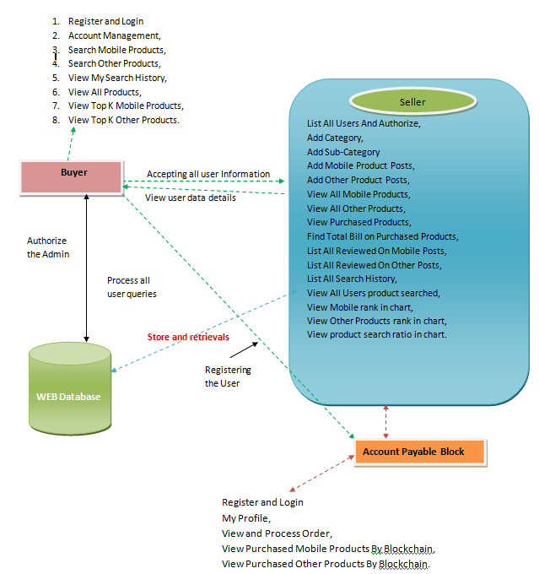
ARCHITECTURE DIAGRAM

Slide 22
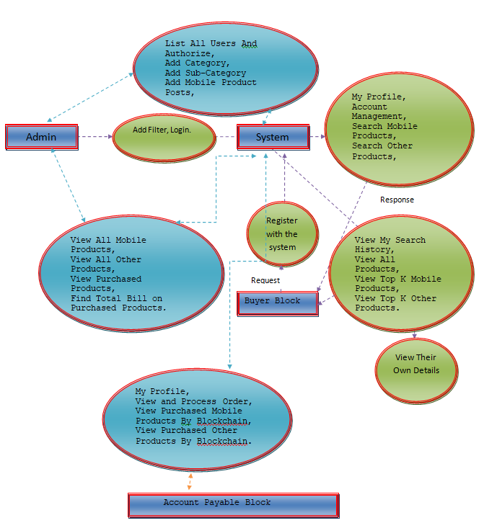
DATA FLOW DIAGRAM

Slide 23
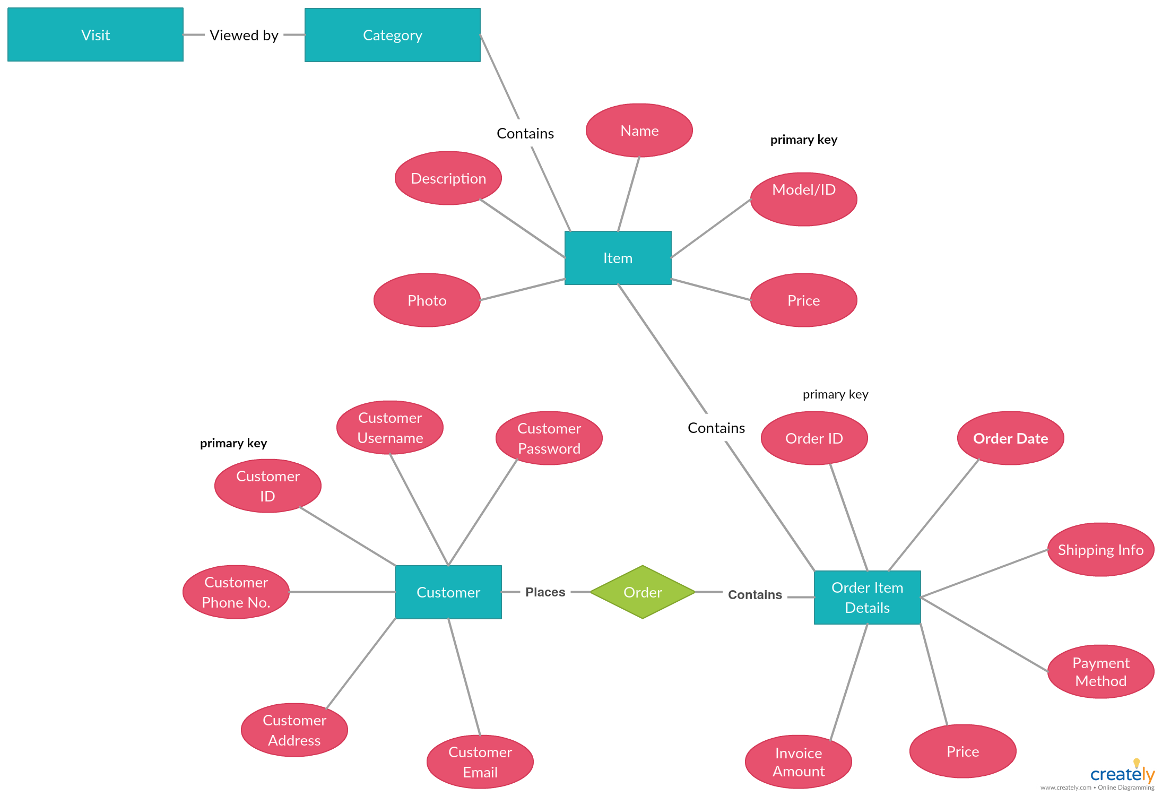
ER- DIAGRAM

Slide 24
ALGORITHAM:
The implementation details of invoice processing in our blockchain-based accounts payable system are presented here.
The notation used in this Concept is explained below.
PO.Q: Purchase order goods quantity.
PO.P: Price for each goods item as per purchase order.
DA.Q: Quantity dispatched by the supplier/quantity received by the shipper.
RA.Q: Quantity accepted by the shipper after the verification by shipper’s goods receiving team.
CI.Q: Invoiced goods quantity by the supplier.
CI.P: Price for each goods item as per the supplier invoice.

Slide 25
testing
Types of Testing:
Unit Testing
This test focuses on each module individually, ensuring that it functions properly as a unit.
Integration Testing
This testing process is to take unit tested modules and builds a program structure that has been dictated by design.
User Acceptance Testing
The system under consideration is tested for user acceptance by constantly keeping in touch with the prospective system users at the time of developing and making changes wherever required.

Slide 26
Continued..
Validation Testing
Validation checks are performed on the Text Field, Numeric Filed, Preparation of Test data, and Using Test data.
Output Testing
After performing the validation testing, the next step is output testing of the proposed system, since no system could be useful if it does not produce the required output in the specified format.

Slide 27
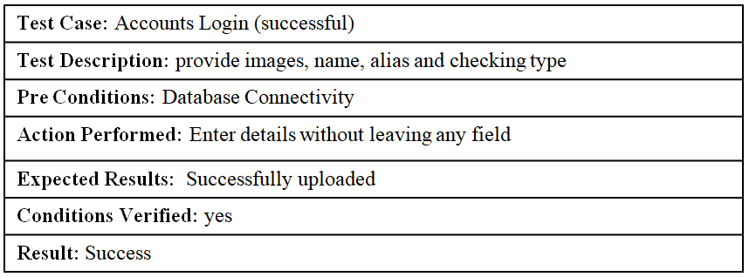
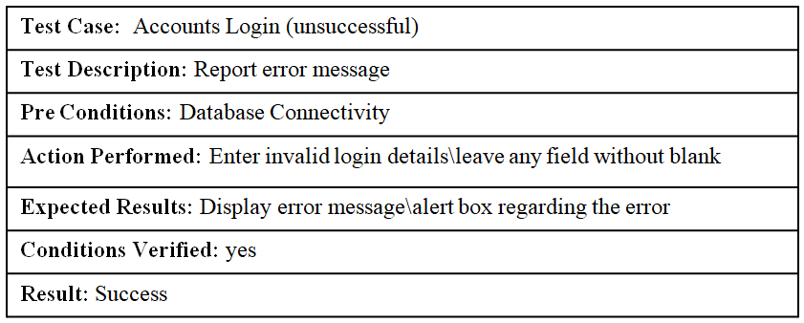
RESULTS OF TESTING
ACCOUNTS TEST CASES:

Slide 28
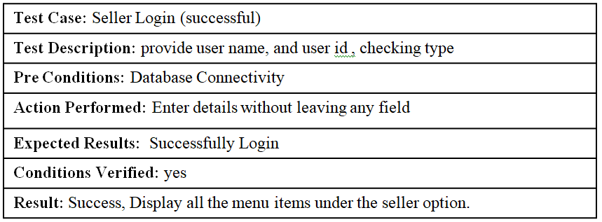
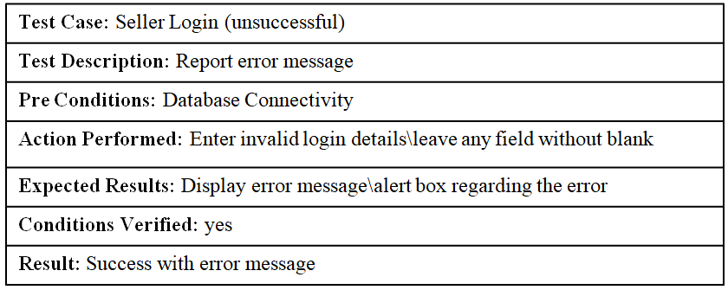
SELLER TEST CASES:

Slide 29
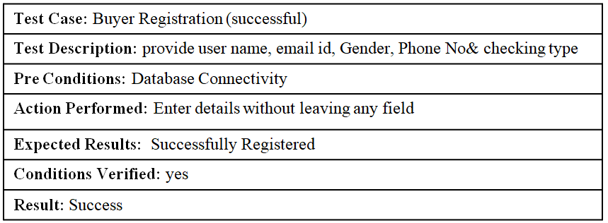
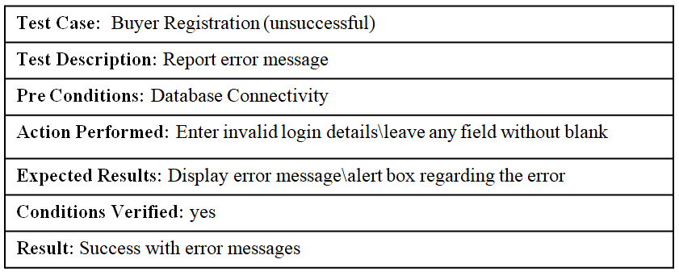
BUYER - REGISTRATION TEST CASES:

Slide 30
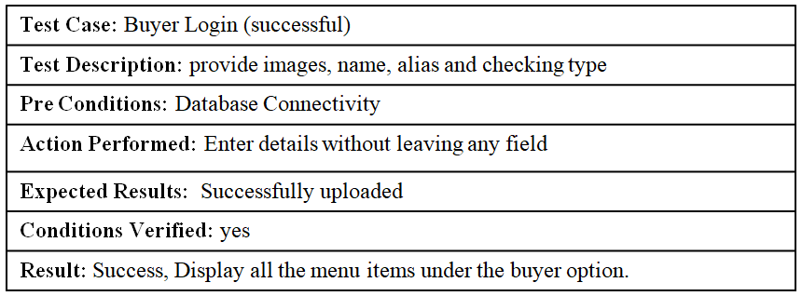
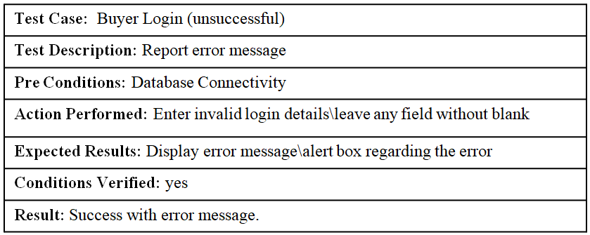
BUYER –LOGIN TEST CASES:

Slide 31
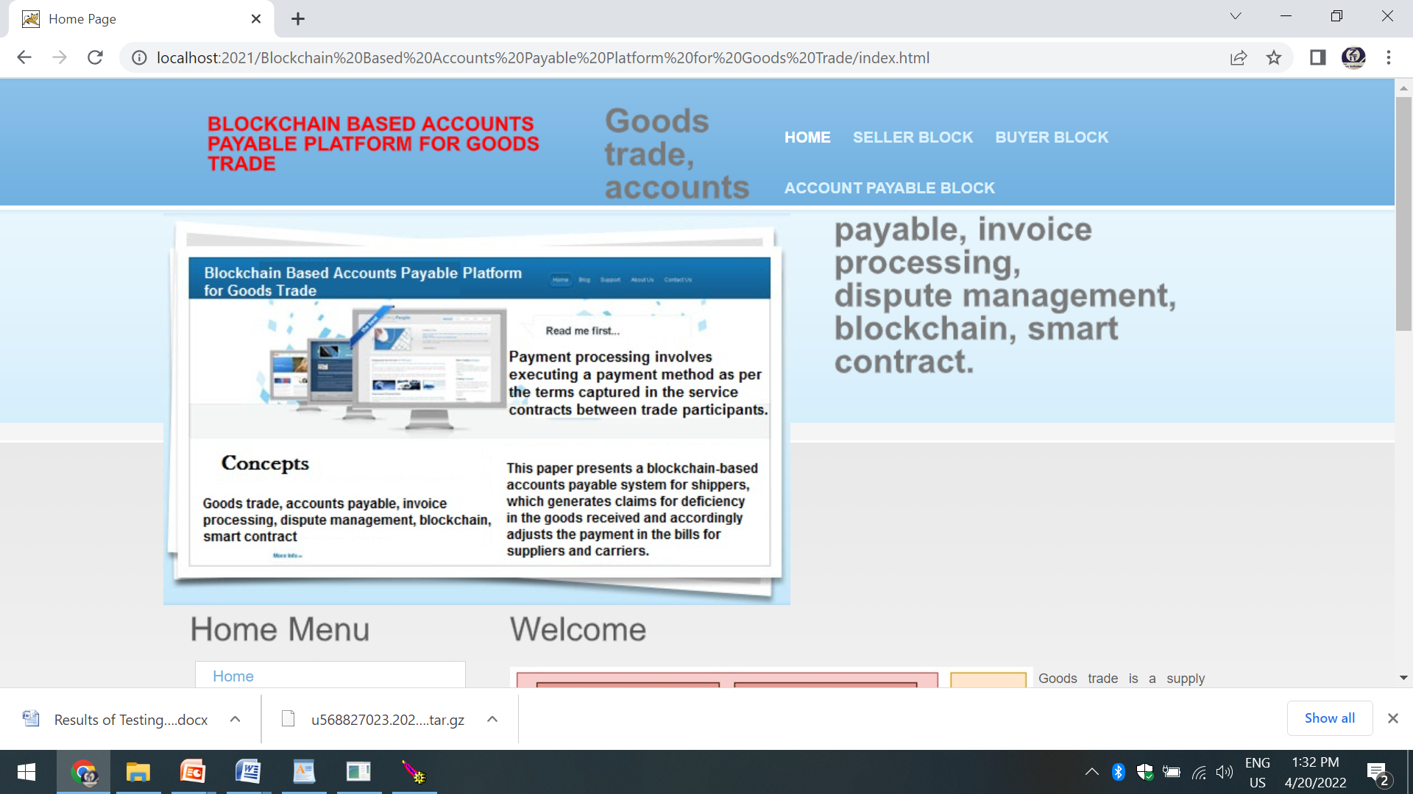
Results analysis
Fig1. Above figure shows the implementation home page

Slide 32

Fig 2. Above figure shows the all the sub menu’s and operations list in SELLER

Slide 33
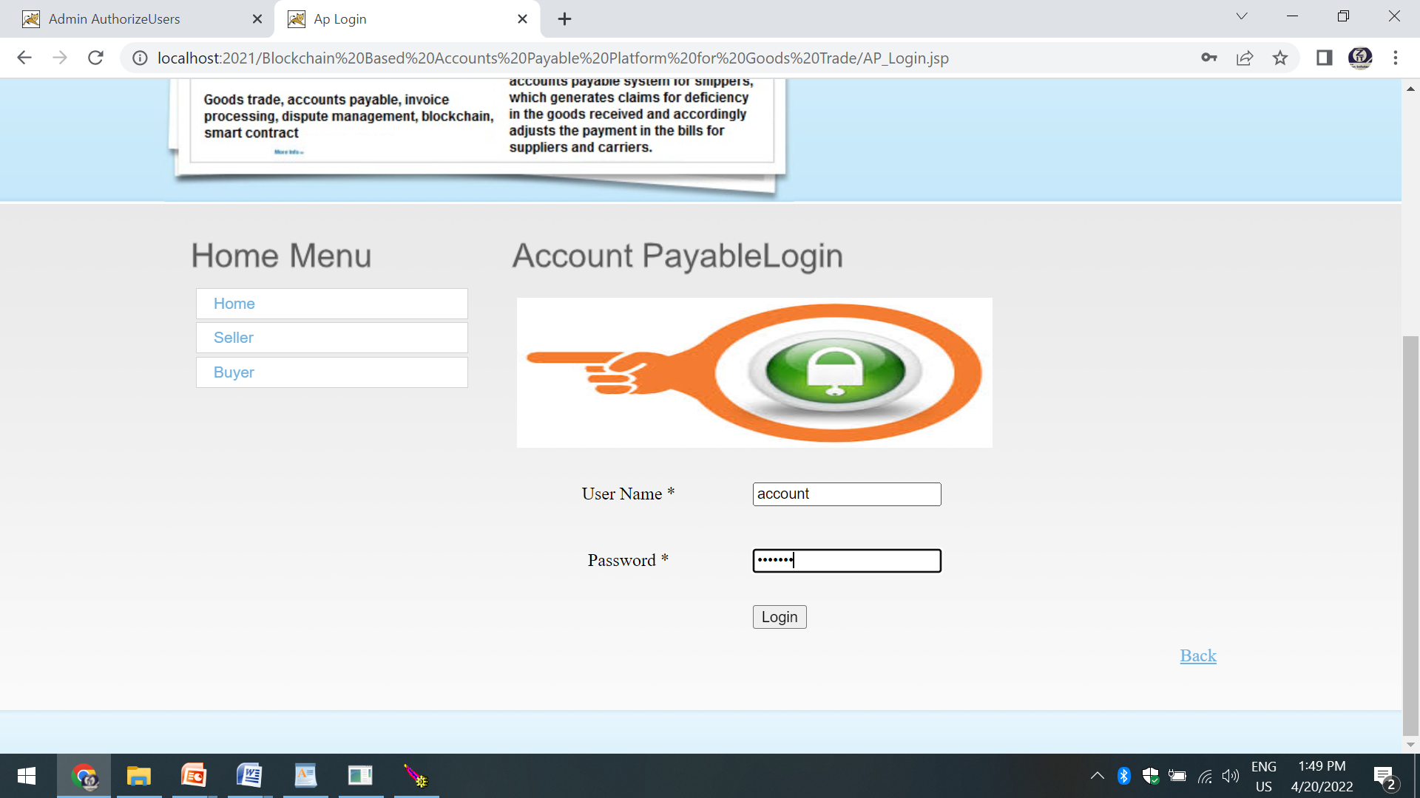
Fig3. Account payable login page

Slide 34
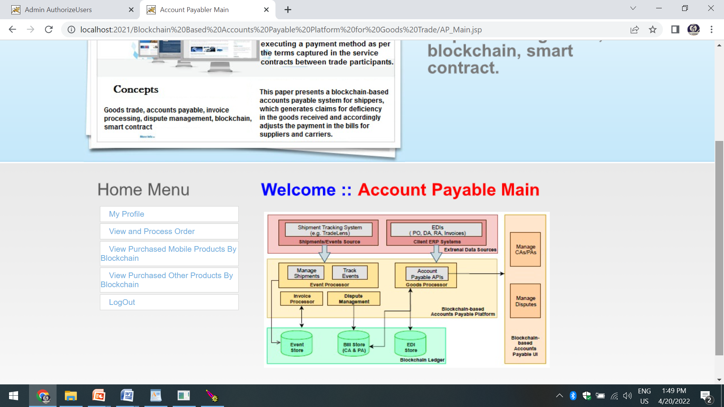
Fig4. Above figure shows Home page of Account Payable

Slide 35
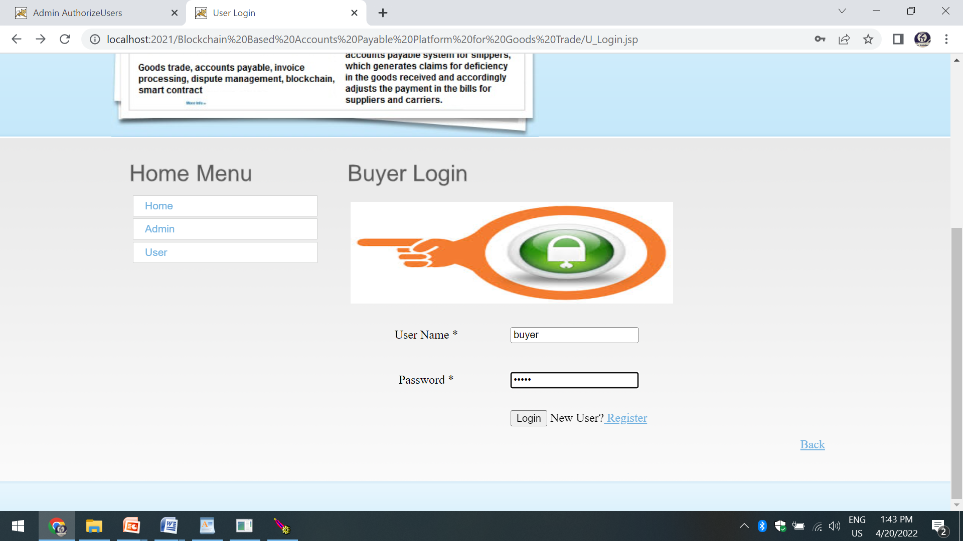
Fig5. Above figure shows the login page of Buyer Login

Slide 36
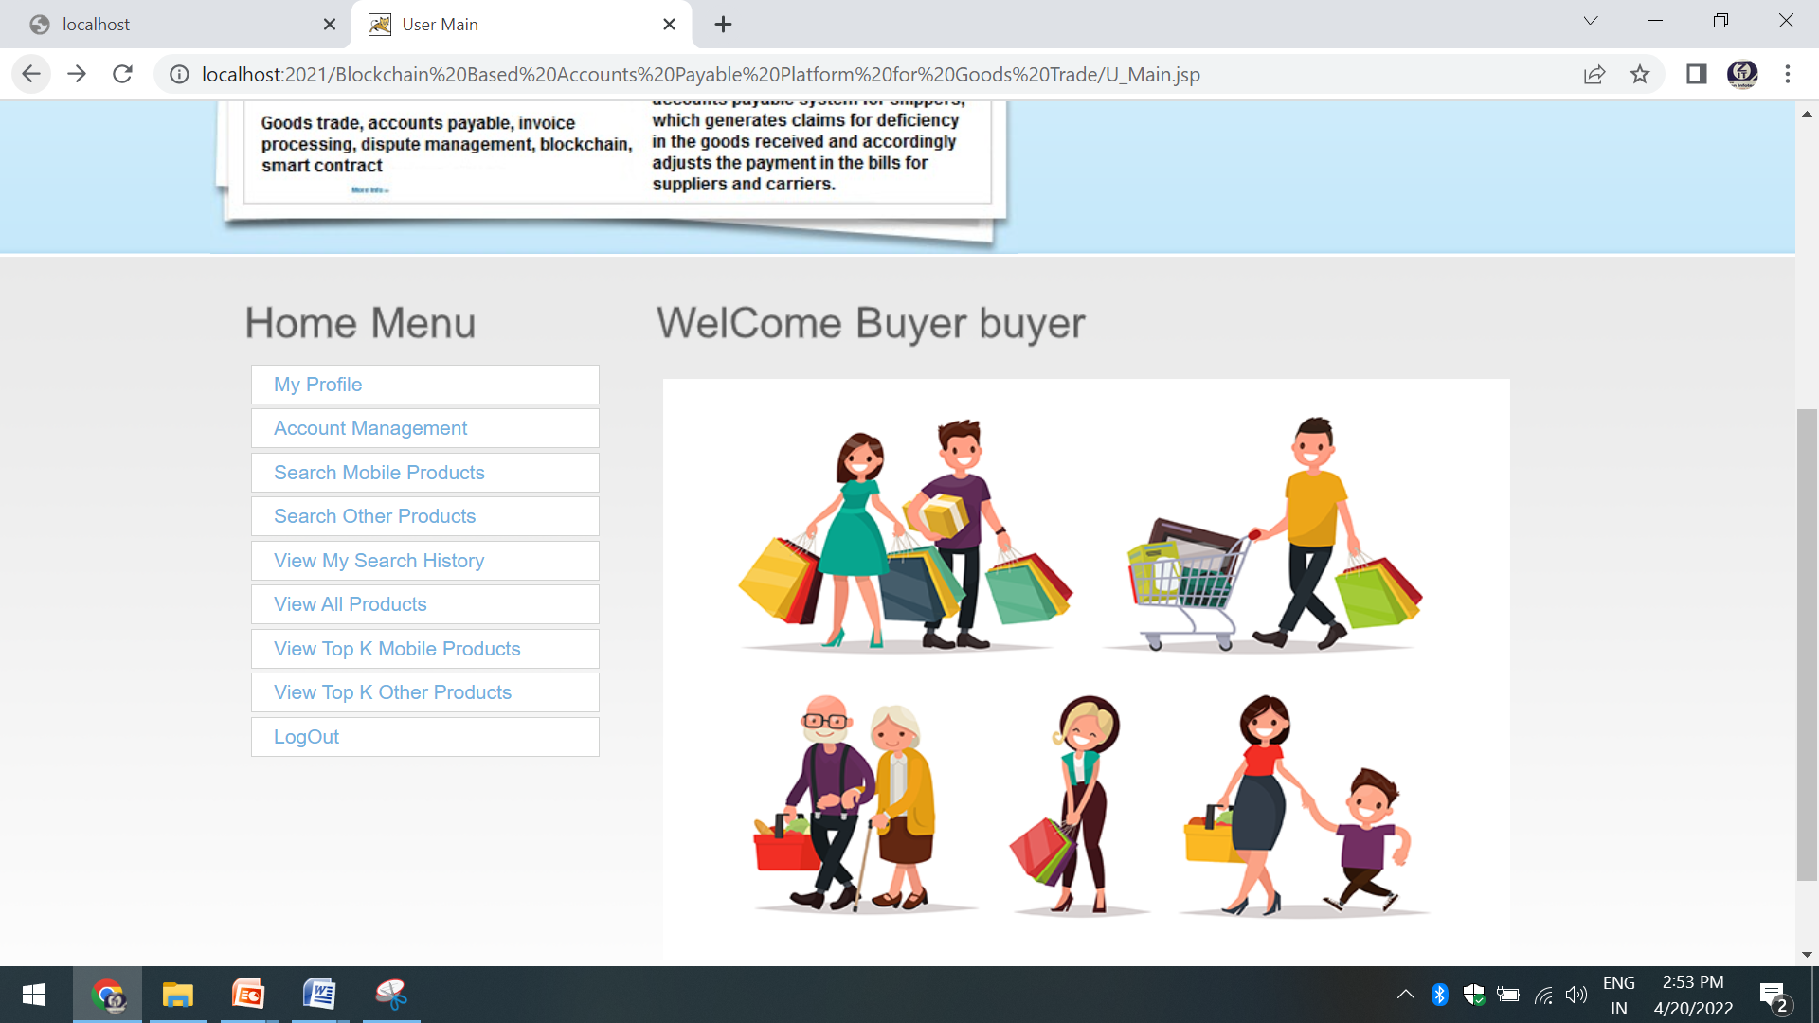
Fig6. Above figure shows the home page of Buyer and all operations of buyer

Slide 37
CONCLUSION
we discussed the need for a block chain based accounts payable system that eliminates the process redundancies (accounts payable vs. accounts receivable), enables efficient invoice processing, and reduces the amount of time spent in reconciling disputes between the transacting participants in goods trade (domestic and global).
We provided details of our block chain-based accounts payable system supporting trusted invoice processing and transparent dispute resolution.

Slide 38
REFERENCES
K. Narayanam, S. Goel, A. Singh, Y. Shrinivasan, S. Chakraborty, P. Selvam, V. Choudhary, and M. Verma, “Blockchain based e-invoicing platform for global trade,” in 2020 IEEE International Conference on Blockchain (Blockchain), 2020, pp. 385–392.
http://ibm.biz/BlockchainSolutionFromWalmartCanadaAndDLTLabs.
S. E. Chang, H. L. Luo, and Y. Chen, “Blockchain-enabled trade finance innovation: A potential paradigm shift on using letter of credit,” Sustainability, vol. 12, no. 1, p. 188, 2020.
J. Chiu and T. V. Koeppl, “Blockchain-based settlement for asset trading,” The Review of Financial Studies, vol. 32, no. 5, pp. 1716–1753, 2019.
Bogucharskov, I. Pokamestov, K. Adamova, and Z. N. Tropina, “Adoption of blockchain technology in trade finance process,” Journal of Reviews on Global Economics, vol. 7, pp. 510–515, 2018.
“we.trade,” https://we-trade.com/.
“Invoice Processing by Accounts Payable,” https://www.purchasing.ucla. edu/accounts-payable/invoice-processing-by-accounts-payable.

Slide 39
“Blockchain for Accounts Payable,” https://cporising.com/2017/05/25/blockchain-for-accounts-payable-an-introduction/.
“Blockchain in Accounts Receivable,” https://netsend.com/blog/blockchain-accounts-receivable/.
“Our Prediction: Blockchain WILL Replace the SupplierInvoice,” https://www.netnetweb.com/content/blog/blockchain-will-replace-the-supplier-invoice.
“2-Way, 3-Way and 4-Way PO-Matching,” https://erp-integrations.com/2017/12/29/2-way-3-way-and-4-way-po-matching/.
“Two, Three, and Four Way Matching,”
https://www.rfsuny.org/media/rfsuny/procedures/ap 2-3-4-way-matching pro.htm.
“Hyperledger Caliper,” https://www.hyperledger.org/projects/caliper.
P. Thakkar, S. Nathan, and B. Viswanathan, “Performance benchmarking and optimizing hyperledger fabric blockchain platform,” in 2018 IEEE 26th International Symposium on Modeling, Analysis, and Simulation of Computer and Telecommunication Systems (MASCOTS). IEEE, 2018, pp. 264–276.
https://www.statista.com/statistics/913398/container-throughput-worldwide/
https://hyperledger-fabric.readthedocs.io/en/release-1.2/endorsement-policies.html.

Slide 40
THANK YOU

